Slide 1
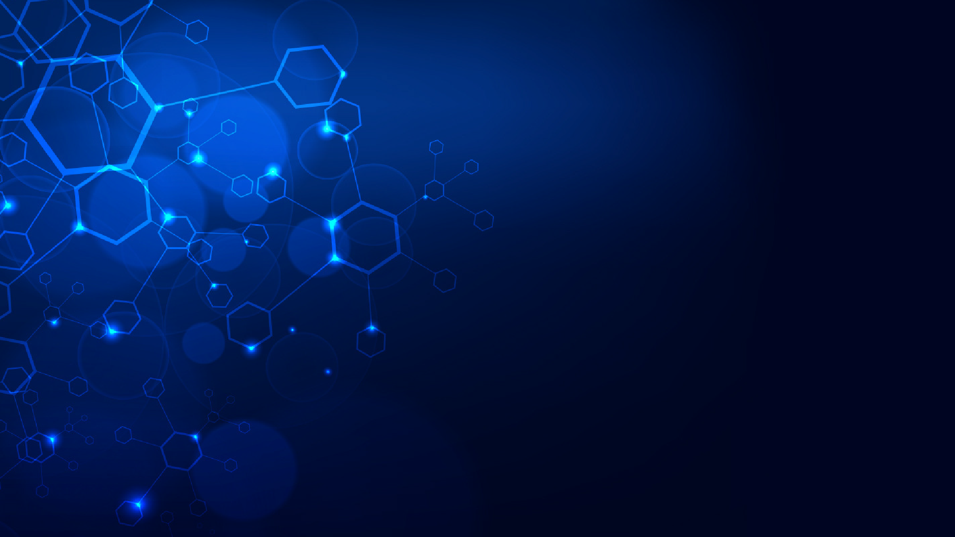
BRAIN TUMOR DETECTION USING CONVOLUTIONAL NEURAL NETWORKS
PRESENTED BY:
(101903030) ANMOL CHADHA
(101903746) HIMANSHU SINGH
(101903027) NITIN SHARMA
(101903535) ARYAN TIWARI
BE FOURTH YEAR COE
CPG NO: 282
UNDER THE MENTORSHIP OF DR. HARKIRAN KAUR ASSISTANT PROFESSOR
CAPSTONE PROJECT PRESENTATION PANEL EVALUATION

Slide 2
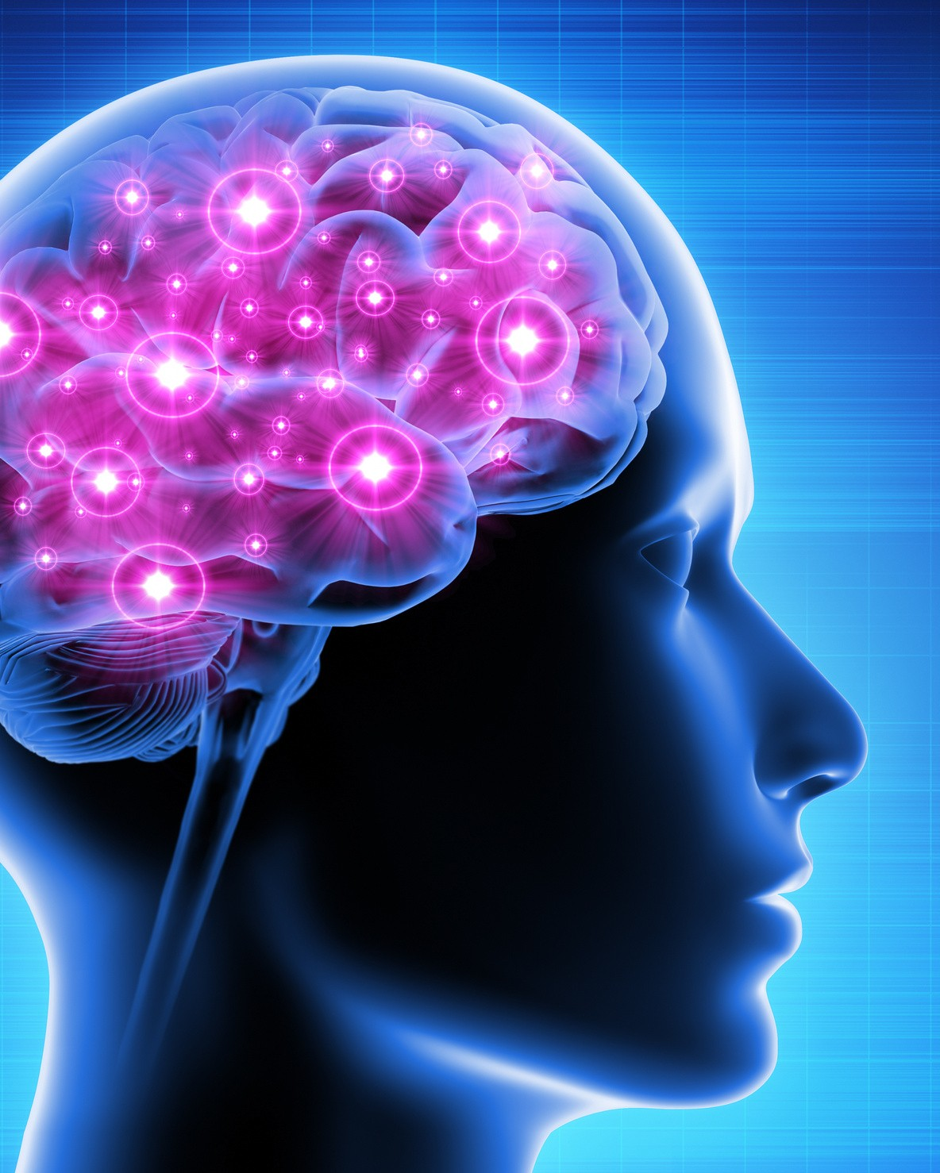
PROBLEM DEFINITION AND SCOPE
Brain tumor segmentation is one of the most important and difficult tasks in medical imaging. Human-assisted manual classification can lead to inaccurate predictions and diagnoses.
In this project, we propose a method for extracting brain tumors from 2D magnetic resonance (MRI) brain images using conventional classifiers and convolutional neural networks.

Slide 3

APPROVED OBJECTIVES
To identify the region of the brain in the image that contains the tumor. This is
done through pre- processing, CNN- based categorization, and post- processing.
To provide doctors with efficient
software to identify tumors and their causes.

Slide 4
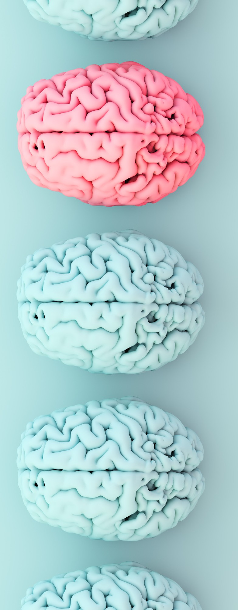
NOVELTY OF WORK
1.) Used Relu activation layer
2.) Instead of taking the images directly ,we used AWS (backend storage databases) to extract images and used S3 and auto scaling groups and load balancers to handle large datasets.
3.) To Threshold the image, we performed a series of erosions and dilations to remove any small regions of noise,for this we used
thresh = cv2.threshold(gray, 45, 255, cv2.THRESH_BINARY)[1]
thresh = cv2.erode(thresh, None, iterations=2)
thresh = cv2.dilate(thresh, None, iterations=2)

Slide 5
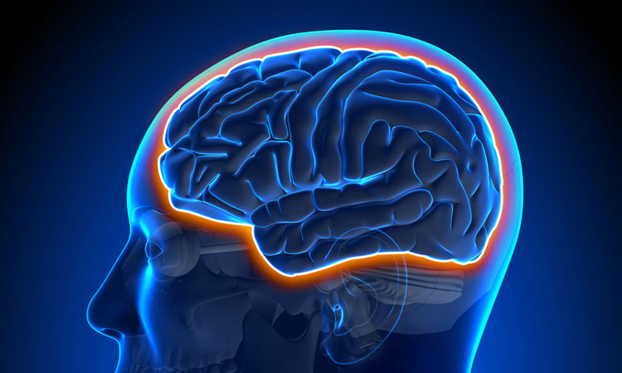
4.) Find contours in thresholded image, and then grab the largest one cnts = cv2.findContours(thresh.copy(), cv2.RETR_EXTERNAL, cv2.CHAIN_APPROX_SIMPLE) cnts = imutils.grab_contours(cnts) c = (cnts, key=cv2.contourArea)
5.) To crop the border and dark parts(not cropped anywhere).
Read the image.
Crop the part of the image representing only the brain.
Resize the image (because the images in the dataset come in different sizes (meaning width, height and # of channels). So, we want all of our images to be (240, 240, 3) to feed it as an input to the neural network.
Apply normalization because we want pixel values to be scaled to the range 0-1.
Append the image to X and its label to y.

Slide 6
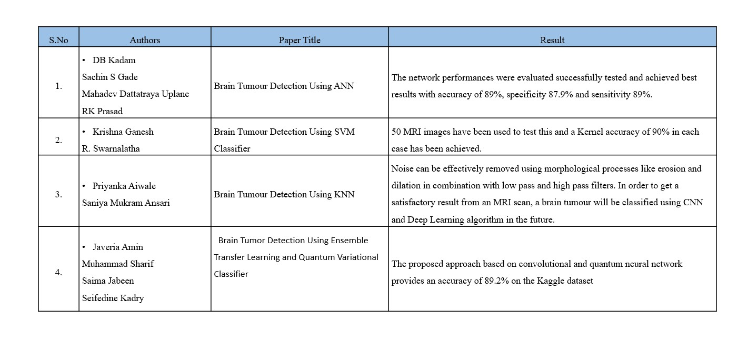
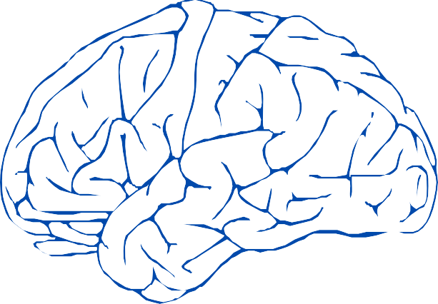
LITERATURE SURVEY

Slide 7
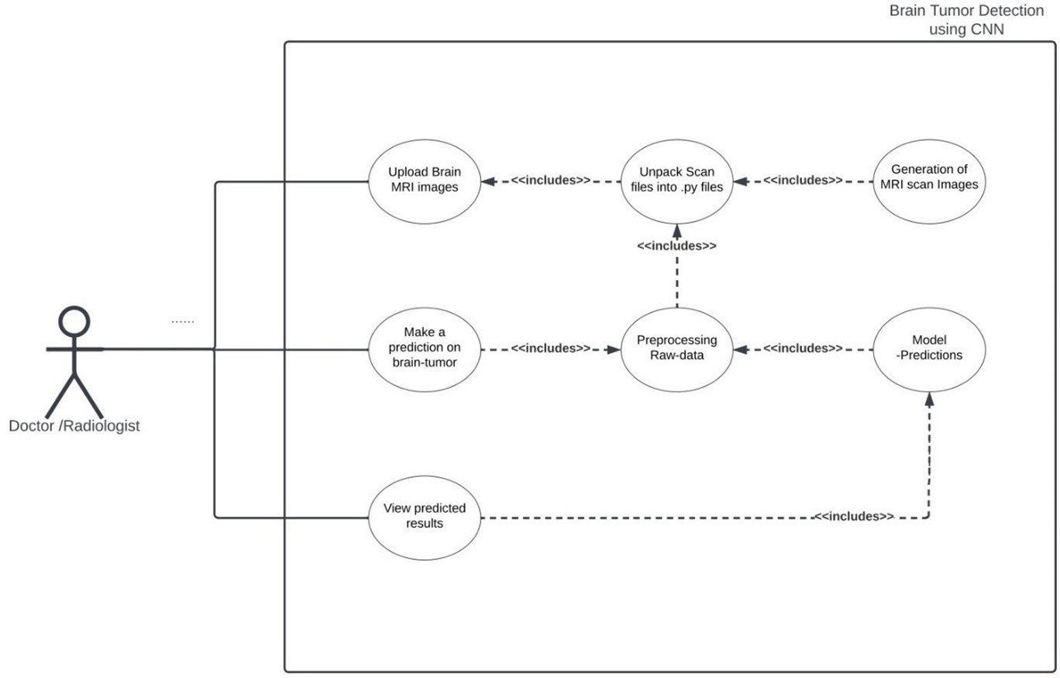
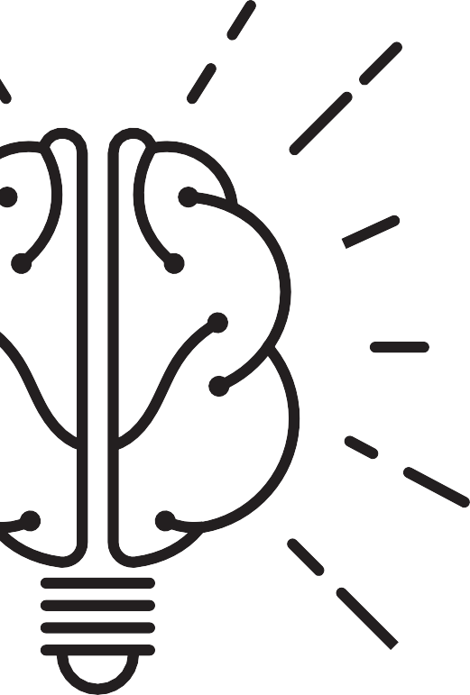

PROJECT ANALYSIS AND DESIGN
Use Case Diagram

Slide 8
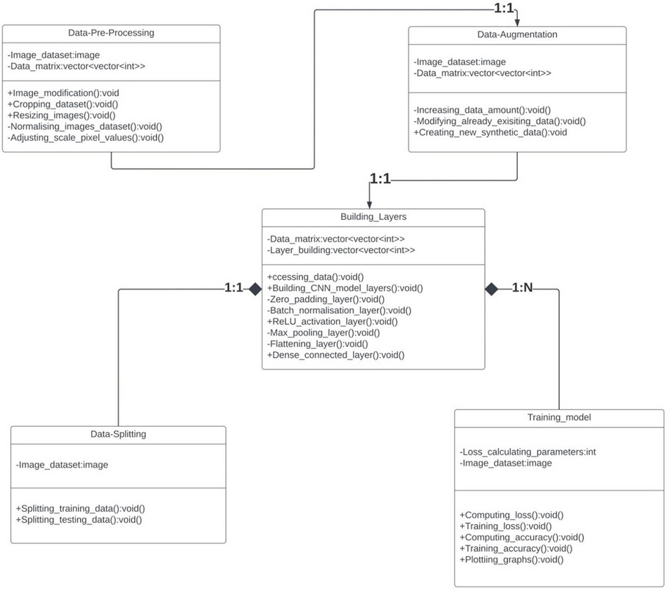
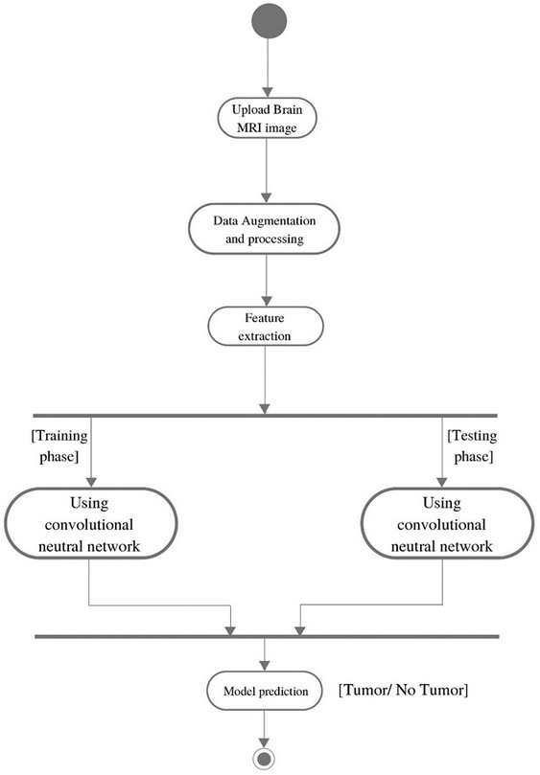
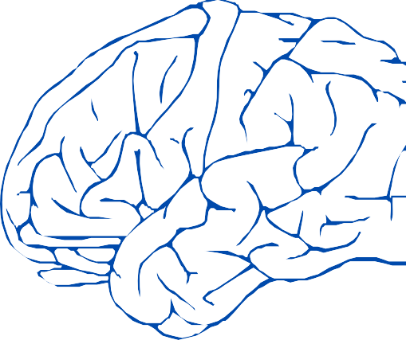
ACTIVITY DIAGRAM
CLASS DIAGRAM

Slide 9
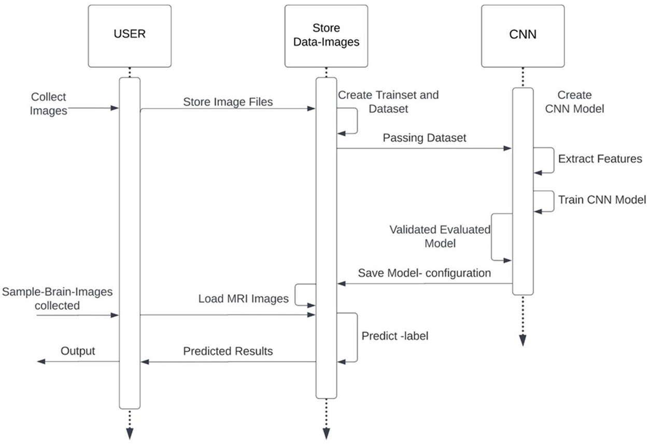
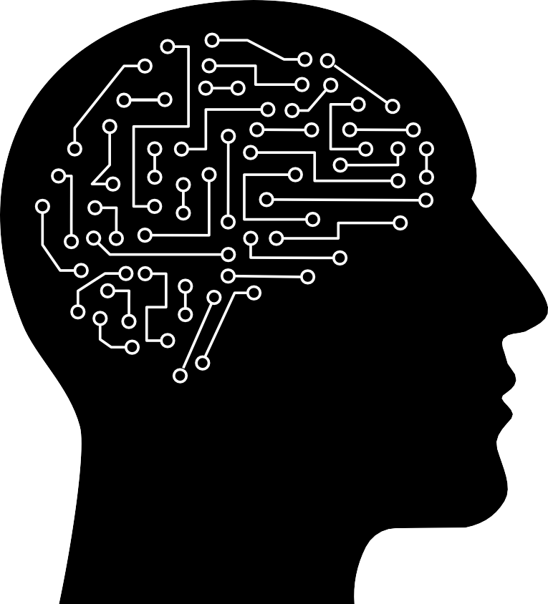
SEQUENCE DIAGRAM

Slide 10
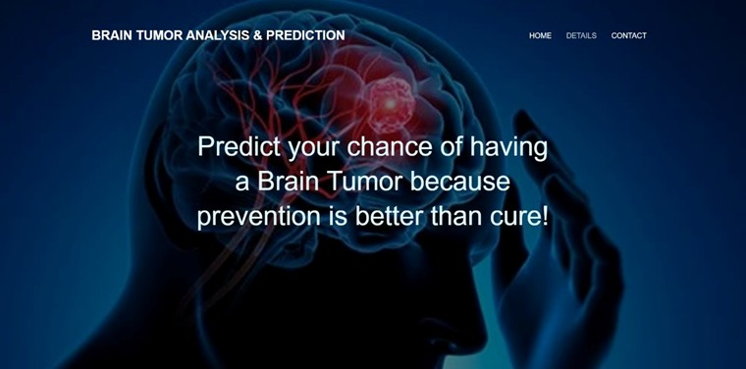
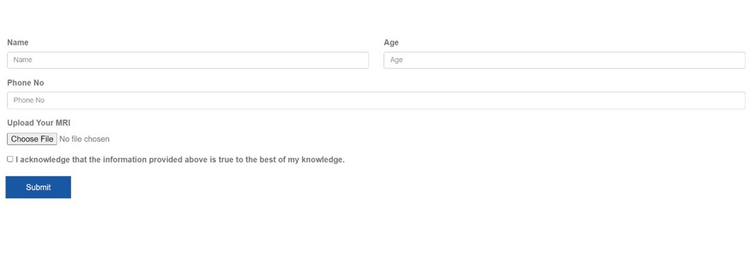
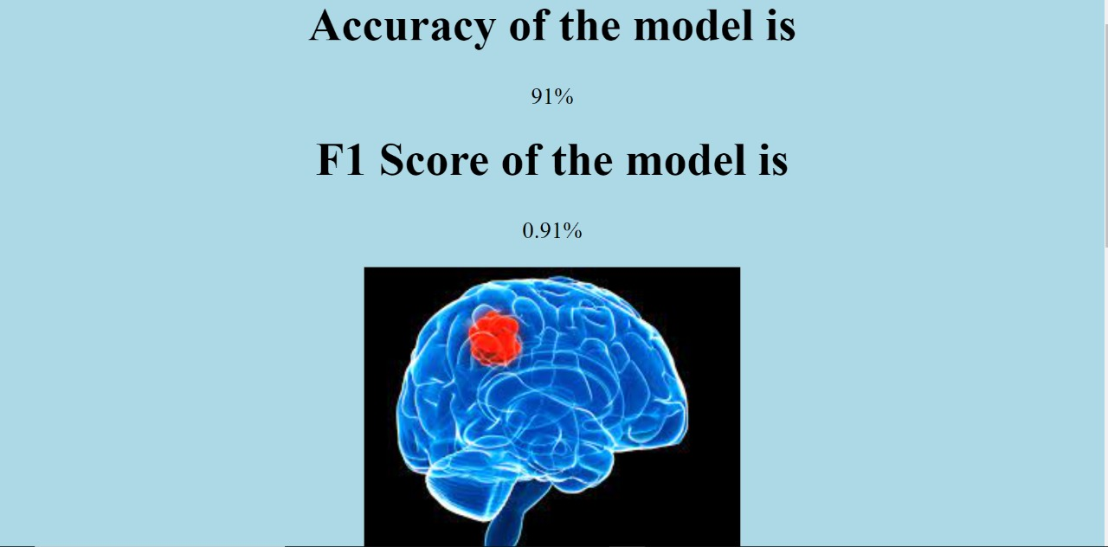

GRAPHICAL USER INTERFACE
Gui Home- The HOME page contains the title, an image, tagline and information about the basic idea. It holds the direct links to DETAILS & CONTACTS.
Gui Details- In DETAILS page, person needs to sign up by adding necessary personal information viz his/her name, phone number, age etc.
Along with that, he/she needs to upload latest MRI reports
Result- It will show the accuracy and F1 score of the model

Slide 11
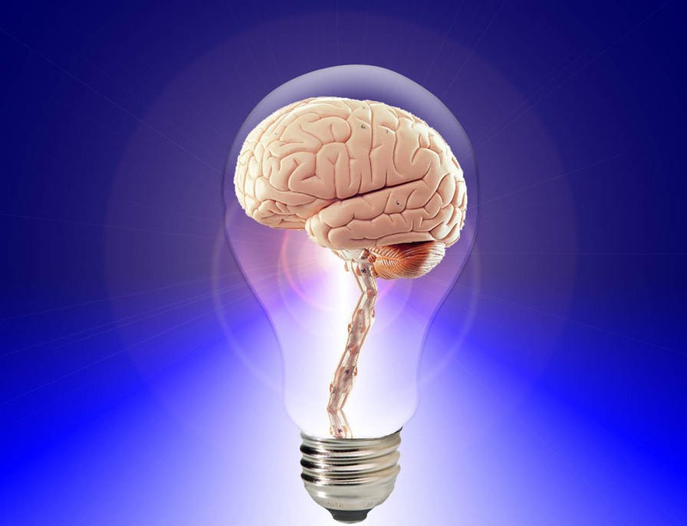
Deep-Learning: Type of machine learning and AI to be used for our model
Convolutional neural network: Deep Learning algorithm which can take in an input Brain MRI image, and analyze tumor
ReLU activation layers: Activation function responsible for transforming the summed weighted input from the node into the activation of the node or output for that input.
Max-pooling layers: Used to summarize the presence of features in an input image.
Internet: Used by users to access our application
TOOLS AND PLATFORM USED

Slide 12
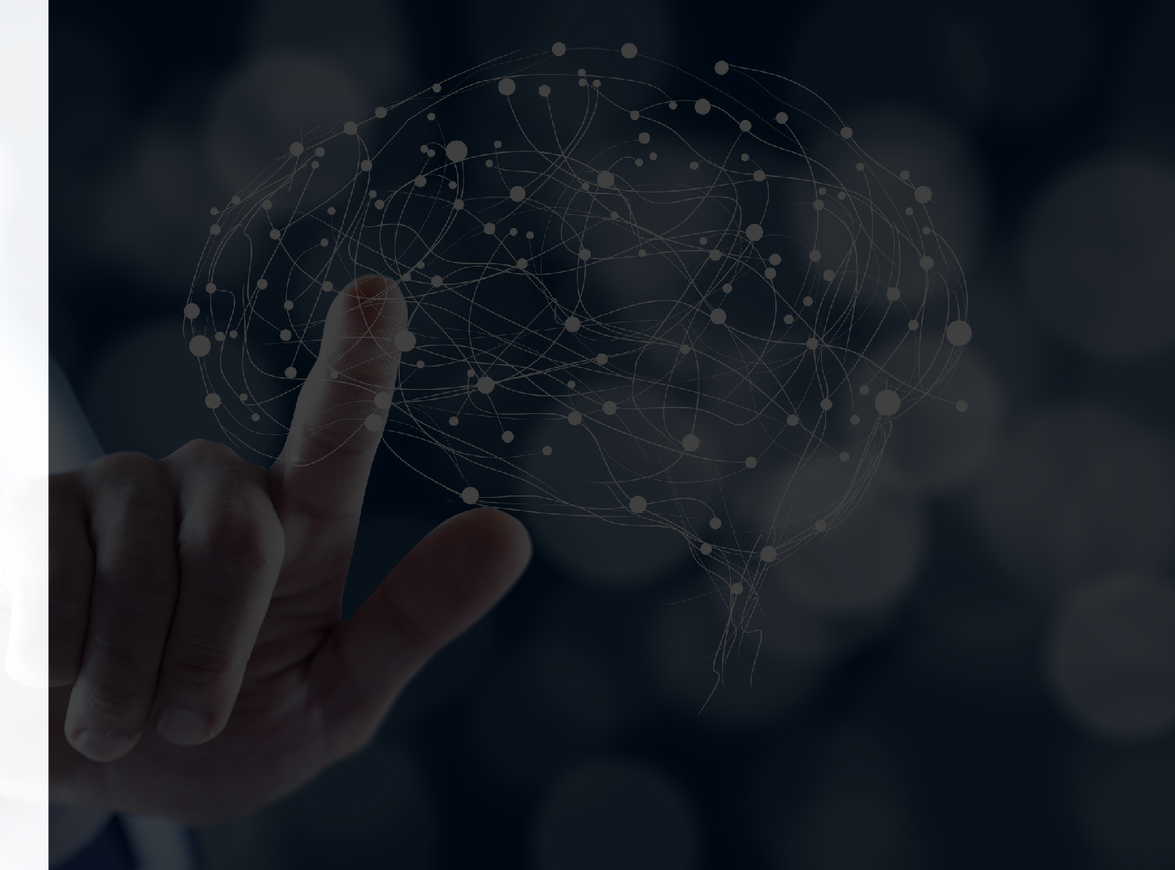
Detailed Design
Data Flow Diagram

Slide 13
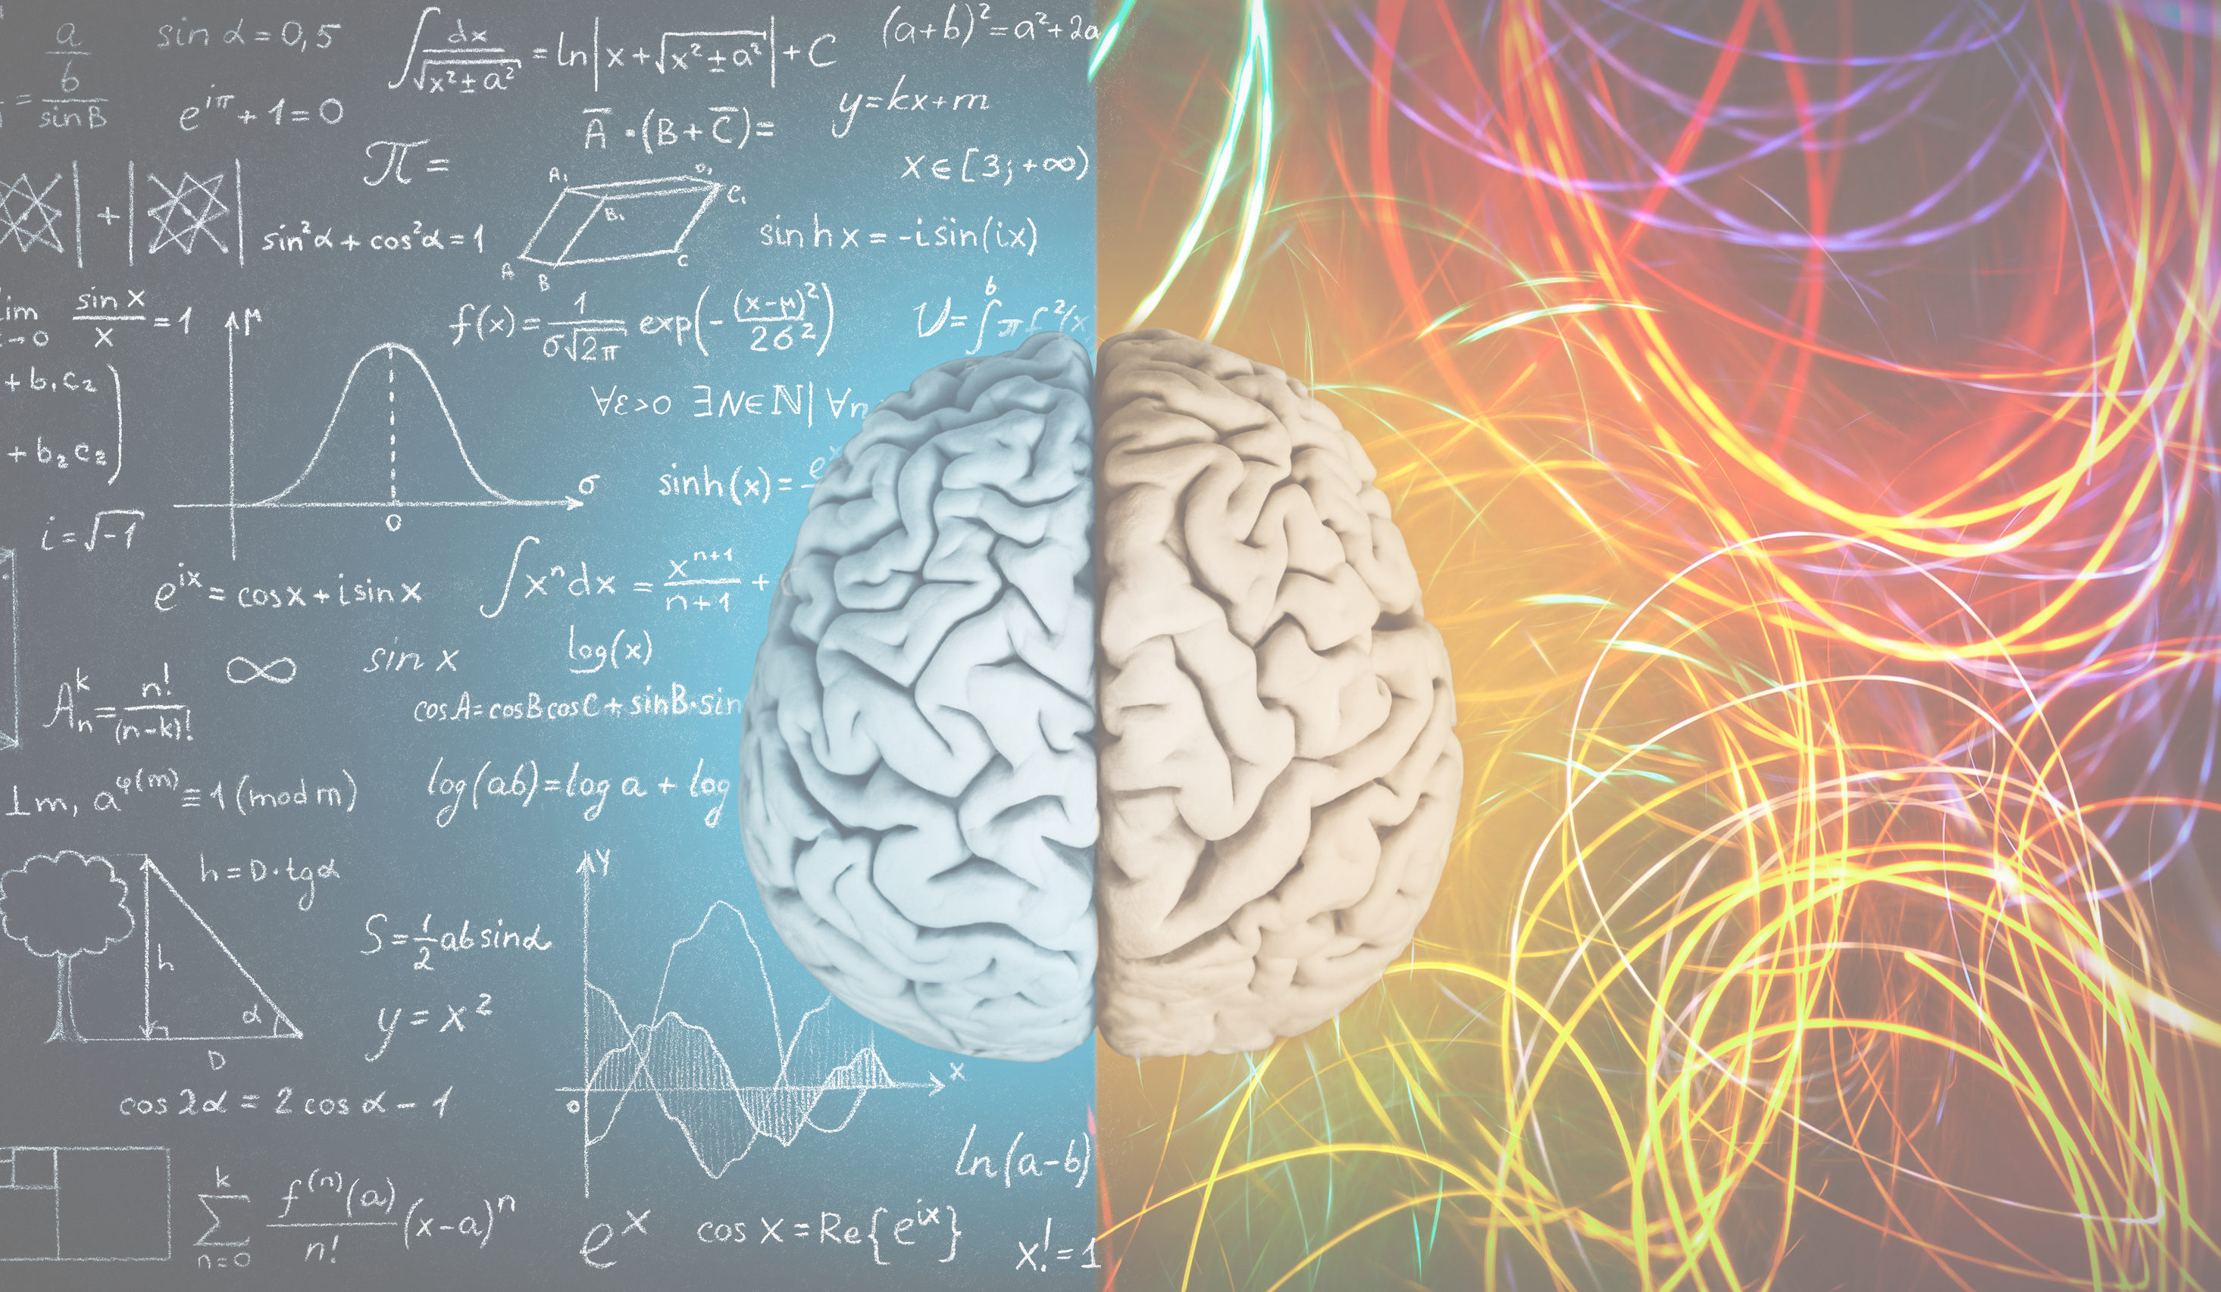
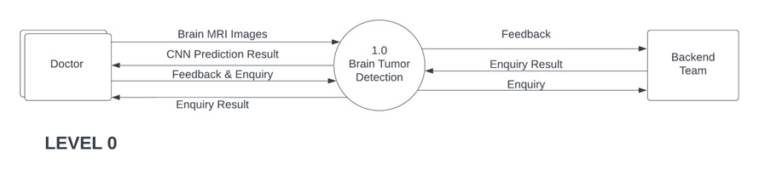
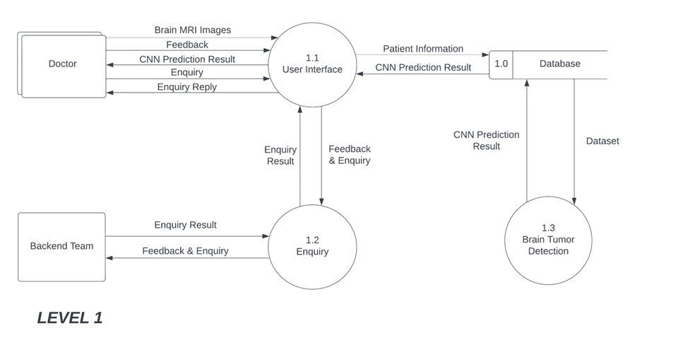
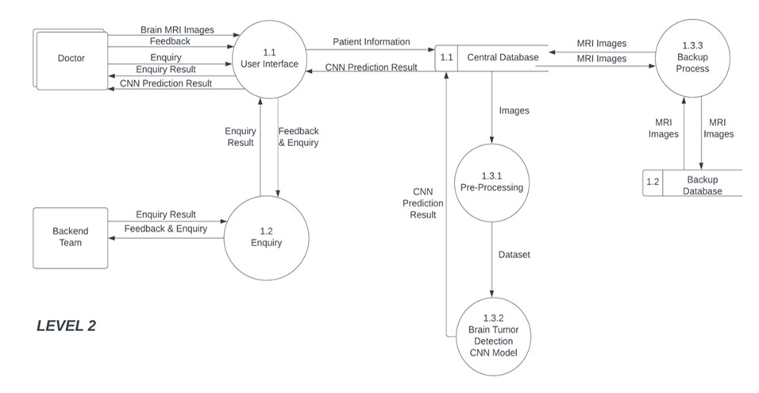

Slide 14
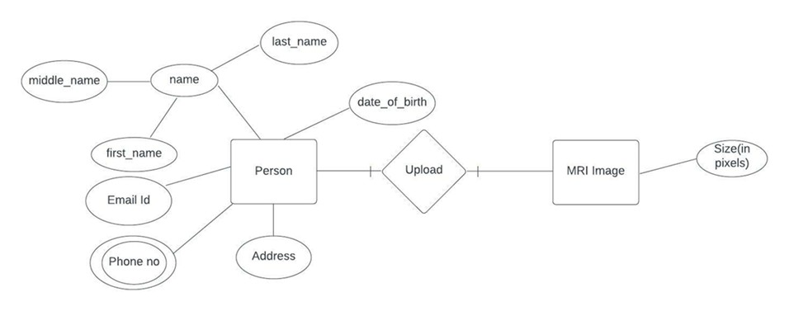
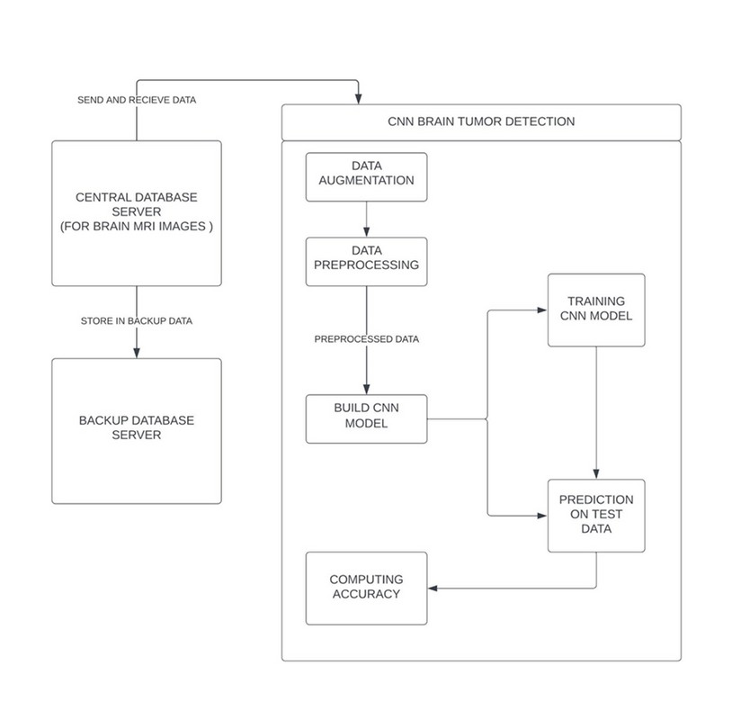

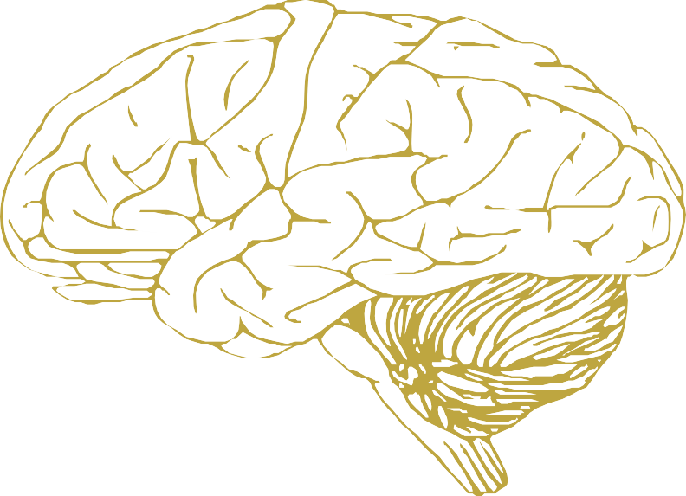
BLOCK DIAGRAM
ER DIAGRAM

Slide 15

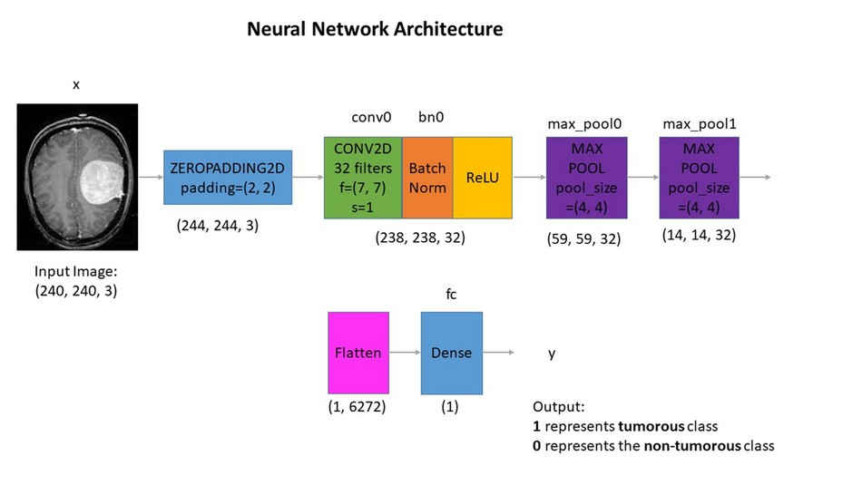
Understanding the architecture:
Each input x (image) has a shape of (240, 240, 3) and is fed into the neural network. And, it goes through the following layers:
a )A Zero Padding layer with a pool size of (2, 2).
A convolutional layer with 32 filters, with a filter size of (7, 7) and a stride equal to 1.
A batch normalization layer to normalize pixel values to speed up computation.
A ReLU activation layer.
A Max Pooling layer with f=4 and s=4.A Max Pooling layer with f=4 and s=4, same as before.
A flatten layer in order to flatten the 3- dimensional matrix into a one-dimensional vector.
A Dense (output unit) fully connected layer with one neuron with a sigmoid activation (since this is a binary classification task
CNN ARCHITECTURE

Slide 16
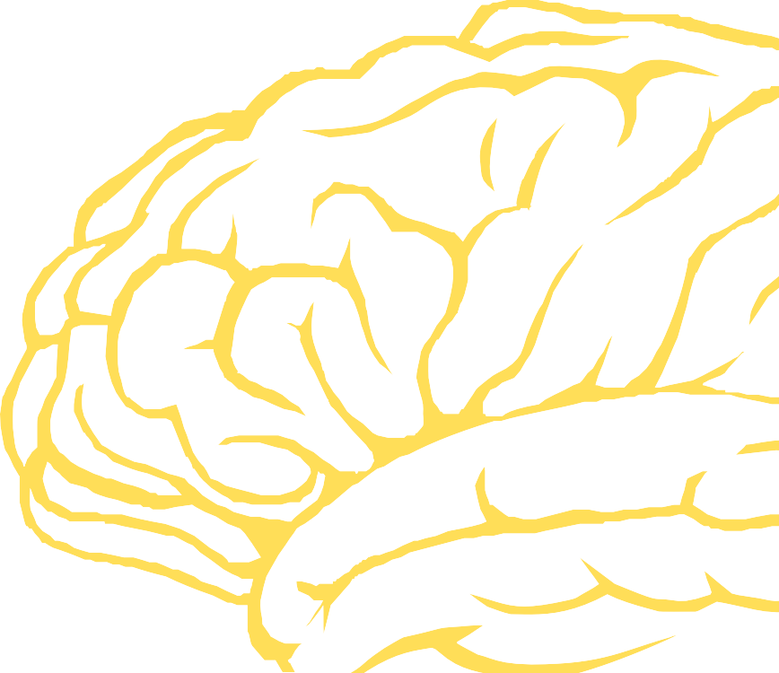
1. Data Augmentation
2. Pre- Processing
4. Build CNN model
3. Split the data
6. Result
5. Training the Model
METHODOLOGY

Slide 17
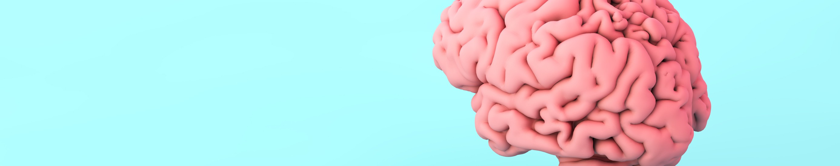
OUTCOMES: -
DETECTION OF BRAIN TUMOR.
BEST VALIDATION ACCURACY ACHIEVED.
DELIVERABLES: -
A CNN BASED MODEL TO HELP THE DOCTORS TO DETECT BRAIN TUMORS IN MRI IMAGES ACCURATELY, SO THAT THE SPEED IN TREATMENT WILL INCREASE A LOT.
A WORKING MODEL.
PROJECT OUTCOMES AND DELIVERABLES

Slide 18
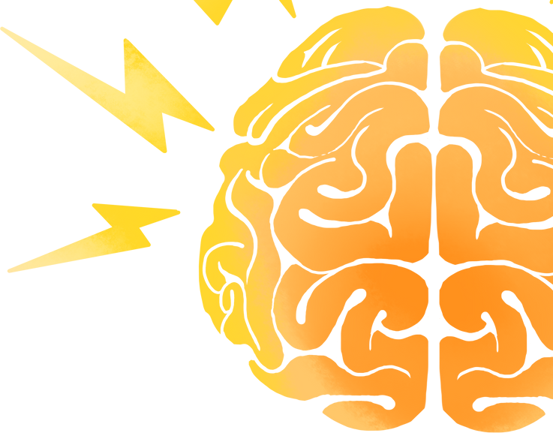
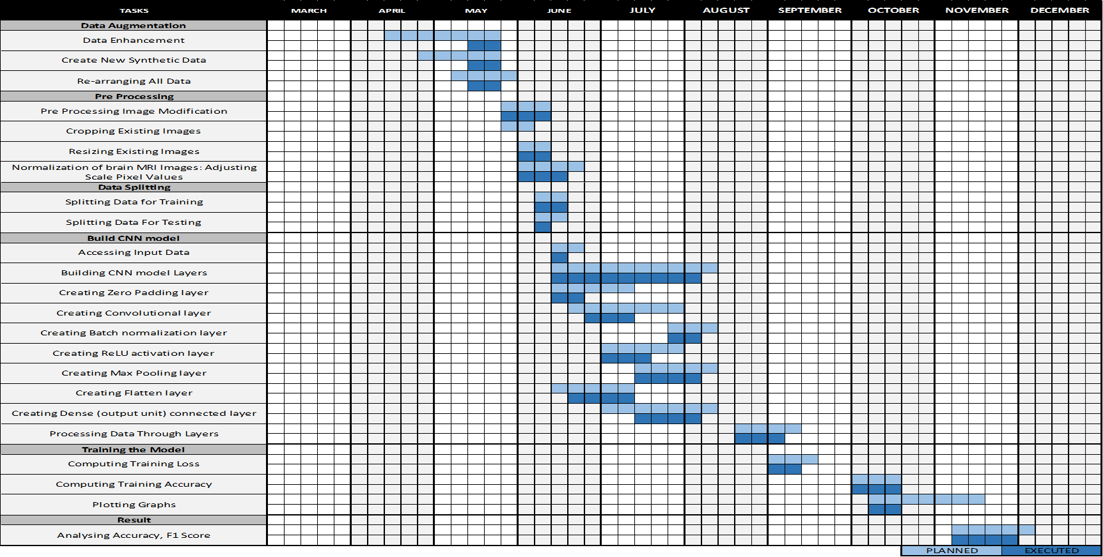
Workflow Diagram

Slide 19
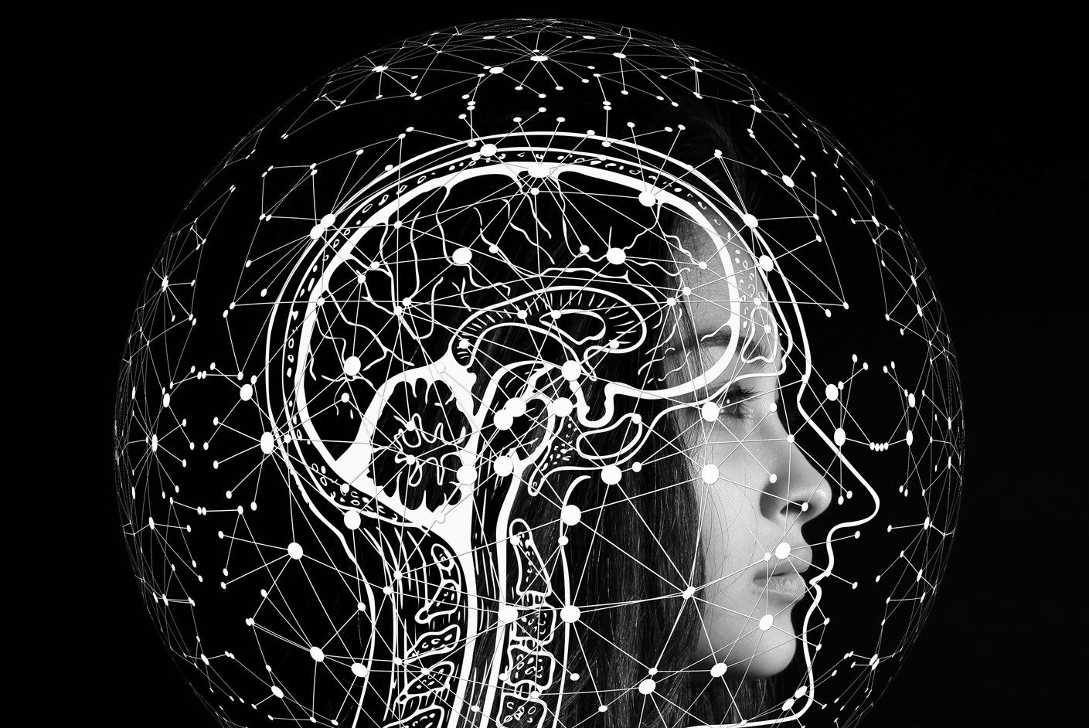
PROFESSIONAL AND TECHNICAL LEARNING
This endeavor helped us recognize the lessons we had gained over the previous four years as well as the strength of our own positions. Whether or not what we are aware of anything is irrelevant. The Internet is there to help us get up and get moving. We only need to be passionate and willing to do the actions we desire. We worked with numerous image processing algorithms and natural language processing strategies while learning how to build websites. So, certainly, it did assist us in becoming accustomed to a variety of surroundings and algorithms.

Slide 20
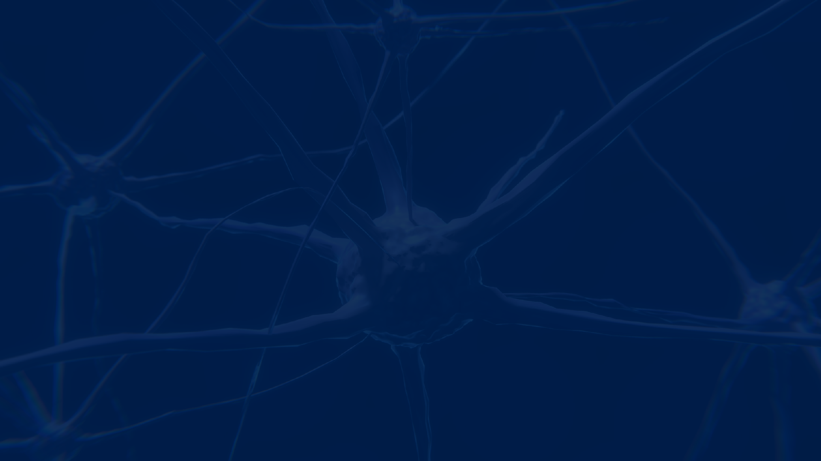
THANK YOU!!
WE BUILD FUTURE

